Slide 1
Being sustainable in your job

Slide 2
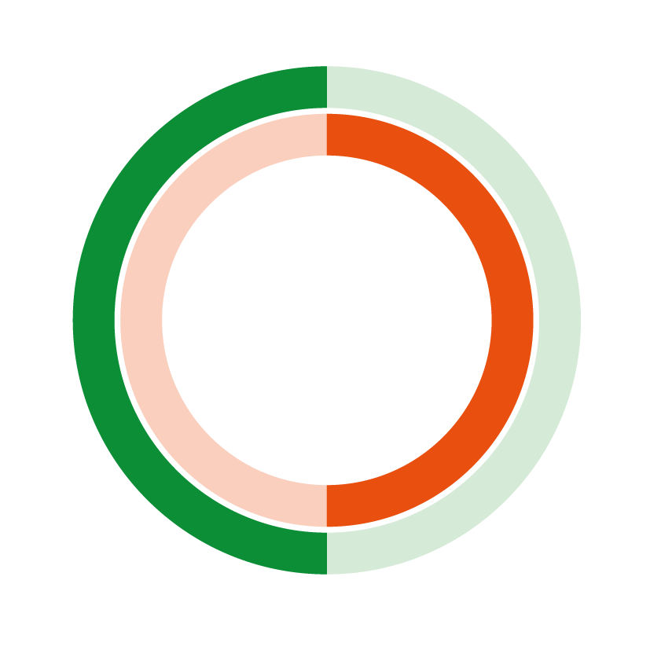
What do I mean by “sustainable”?
1) able to continue over a period of time
causing, or made in a way that causes, little or no damage to the environment and
therefore able to continue for a long time
(Cambridge English Dictionary online)
Where does this apply to you?

Slide 3
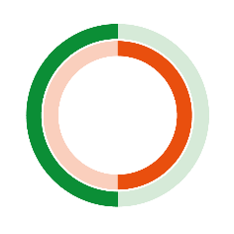
Sustainability
Social
Economic
Making your “community” fairer, with more opportunities for work & personal growth
Social Sustainability
Making your changes affordable, reducing costs long-term & increasing income
Environmental
Economic Sustainability
Decarbonising your “community”, reducing environmental impact & eliminating waste.
Environmental Sustainability

Slide 4
Leadership of Sustainable Change:
an approach to consider
What is going on for YOU, as a leader in the workplace?
SELF
Who’s involved?
Who should be involved?
What help do you need?
STAKEHOLDERS
ORGANISATION
What else is going on in your organisation? What are the competing priorities?
© ADCL, after Adair’s Task-centred Leadership, plus Dinwoodie et al, Center for Creative Leadership

Slide 5
It’s in EVERYTHING you will ever do
How you live your life, in work and at home
How do you make your choices?
What do you prioritise to make life better for you?
What compromises are you making?
How you behave in work
What choices do you make?
What compromises are you making?
Who are you allowing to influence you?
Where does “growth” fit?
How you lead
What choices do you make? Based on what?
What behaviours do you model?
What are you prepared to stand for?

Slide 6
Final Quotes
“Lasting change is a series of compromises.
And compromise is alright, as long your values don't change”.
Dame Jane Goodall
English primatologist, anthropologist and conservation advocate
“The Earth is a fine place and worth fighting for”.
Ernest Hemingway
Writer

Slide 7
Contacts
LinkedIn
https://www.linkedin.com/in/astriddaviesconsulting/
https://www.linkedin.com/showcase/future-leaders-breakfast%C2%AE/
Instagram
@adclcoaching
Website
www.astriddaviesconsulting.com

